Slide 1

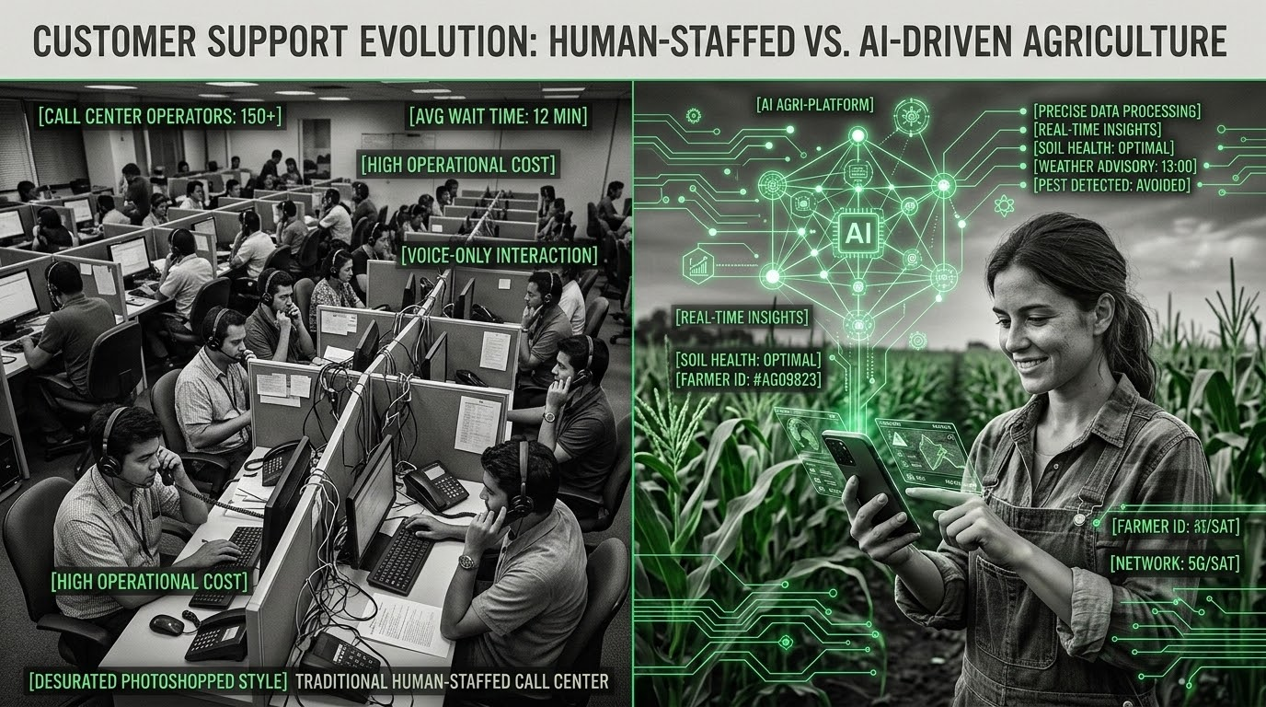
AUTONOMOUS MULTIMODAL
ROUTING ARCHITECTURE
IN PRECISION AGRICULTURE
A Comprehensive Evaluation of Agentic Systems
for the Global South
MULTIMODAL AI
PRECISION AGRI
This presentation focuses on delivering precision agronomic intelligence to secure global food systems.
AUTONOMOUS MULTIMODAL ROUTING ARCHITECTURE
JULY 2026

Slide 2
AGRICULTURAL INFORMATION ASYMMETRY
Smallholder farmers across the global south, particularly in northern India, are constantly navigating severe information asymmetries. They must make critical decisions amidst volatile weather patterns, sudden pest outbreaks, and rapidly fluctuating market prices. Historically, these farmers have relied on traditional, human-staffed Kisan Call Centres (KCC) for agronomic guidance.
To secure global food systems and empower smallholder farmers, there is an urgent need for a scalable, automated alternative that can bypass these human bottlenecks and deliver instant, localized, and highly accurate agronomic intelligence directly to the field.
BOTTLENECK WARNING: Legacy human-staffed systems suffer from extreme latency, immense call volume, and vernacular disconnects.
AUTONOMOUS MULTIMODAL ROUTING ARCHITECTURE
01-JUL-2026

Slide 3

SYSTEM ARCHITECTURE
MULTI-SOURCE AGENTIC RAG
Autonomous "Traffic Cop" RAG
The proposed solution is a highly advanced Multi-Source Agentic Retrieval-Augmented Generation (RAG) framework. Operating as an autonomous multimodal routing architecture, it acts as an intelligent "Traffic Cop" designed to seamlessly digest and process highly unstructured, heterogeneous inputs directly from the field.
It handles complex vernacular voice queries, transliterated/code-mixed text (Hinglish), and in-the-wild, low-resolution crop imagery. Once ingested, the architecture instantly classifies user intent and routes the query.
Complex agronomic queries route to specialized vector databases like ChromaDB for agricultural guidelines, while pricing queries hit real-time live Agmarknet APIs for market data, or escalate to human experts as needed.
INGESTION ENGINE
Voice, Hinglish, Crops
INTENT ROUTER
Autonomous Traffic Cop
CHROMADB VECTOR
Agronomic Guidelines
AGMARKNET API
Real-Time Price Data
FALLBACK: ESCALATION TO HUMAN EXPERTS
AUTONOMOUS MULTIMODAL ROUTING ARCHITECTURE
07/2026

Slide 4
LOCALIZED VERNACULAR INGESTION
Standard multilingual models like mBERT collapse on transliterated and code-mixed Indian vernaculars due to lack of localized vocabulary.
Localized stack integrates MuRIL, IndicBERT, and BhaavNet to accurately parse complex dialectal shifts.
Fine-tuning is conducted on historical KCC logs and AgriGov datasets to maximize intent classification accuracy.
MuRIL
IndicBERT
BhaavNet
AUTONOMOUS MULTIMODAL ROUTING ARCHITECTURE
JUL 2026

Slide 5
LAB-TO-FIELD COMPUTER VISION INTERVENTION
Standard CNNs like EfficientNet-B0 achieve 99% accuracy on clean, lab-generated datasets (PlantVillage), but suffer catastrophic collapse (73% accuracy) when deployed in real-world fields. This failure is driven by chaotic backgrounds, variable lighting, severe occlusions, and overlapping foliage.
3-STAGE ARCHITECTURAL INTERVENTION
STAR-Net Segmentation: First isolates complex, irregular fungal lesion morphologies before passing to classification.
Domain Adaptation: Leverages Fourier FDA and sim2real transfer techniques to bridge the synthetic-to-field visual gap.
YOLOv8 Edge Models: Integrates single-stage models to provide rapid, localized bounding box generation and edge detection.
LAB ACCURACY (PLANTVILLAGE)
99%
Optimal environment, uniform illumination & clear crops
UNADAPTED FIELD ACCURACY
73%
Catastrophic gap driven by real-world field complexity
COMPUTER VISION FIELD INTERVENTION PLATFORM
2026-07-01

Slide 6
VISION-LANGUAGE MODELS
SCOLD FRAMEWORK INTEGRATION
To further enhance the system's analytical capabilities, the architecture integrates advanced Vision-Language Foundation Models, specifically highlighting the SCOLD (Soft Context-Aware Object and Language Distillation) framework. This dual-stream architecture combines Swin-T and RoBERTa alongside Context-Aware Soft Targets (CST) to fundamentally transform opaque black-box image classification into accurate, explainable image-text retrieval.
By aligning visual features directly with rich textual descriptions, the model's output becomes highly explainable. Instead of merely outputting a generic class label, the system generates structured, descriptive text detailing exact visual symptoms. This structured output serves as high-fidelity grounding context for downstream LLMs, ensuring agronomic advice is tied directly to observable evidence, dramatically reducing misdiagnosis risks.
STACK COMPONENTS
Swin-T
SCOLD
Swin-T
RoBERTa
CST
CST ALIGN
RoBERTa
DUAL-STREAM RETRIEVAL FLOW
AUTONOMOUS MULTIMODAL ROUTING ARCHITECTURE
07.2026

Slide 7
GEOSPATIAL BOUNDARIES IN AGRONOMIC RAG
Deploying generic Retrieval-Augmented Generation (RAG) is insufficient and potentially highly dangerous in an agricultural context. Agronomic advice must be hyper-personalized and strictly bounded by precise geographic and environmental parameters.
To achieve this, the architecture leverages advanced spatial reasoning frameworks like the GeoGraphRAG-Soil (GGRS) network. This system intersects textual agronomic knowledge with hard geospatial rules. We utilize ChromaDB for strict pre-retrieval metadata filtering, ensuring that vector searches are rigidly restricted to specific soil types, localized climate zones, and regional crop histories (for example, explicitly filtering for the 'Punjab region' and 'saline soil').
CORROSION & DRIFT RISK: Physical IoT sensors drift and corrode rapidly in saline soil. Readings must be processed probabilistically and cross-verified against satellite baselines.
AUTONOMOUS MULTIMODAL ROUTING ARCHITECTURE
2026-07-01

Slide 8
UNCOMPROMISING GENERATIVE GUARDRAILS
AI hallucinations in agriculture translate directly to crop failure and severe financial ruin for farmers.
Neurosymbolic guardrails enforce hard logical constraints directly on LLM outputs.
Multi-agent validation setup utilizes automated evaluator agents to verify advice before transmission.
"In high-stakes farming, correctness is non-negotiable. Natural fluency must never compromise factual faithfulness."
AUTONOMOUS MULTIMODAL ROUTING ARCHITECTURE
07/2026

Slide 9
RAGAS EVALUATION FRAMEWORK
To guarantee continuous system safety and reliability, the architecture relies heavily on the rigorous RAGAS Evaluation Framework. This framework establishes four foundational, mathematical safety pillars that dictate the operational boundaries of the Generative AI.
First, Context Precision evaluates the signal-to-noise ratio, ensuring that only the most highly relevant and accurate source documents are retrieved from the vector database. Second, Context Recall measures completeness, guaranteeing that the system successfully captures all necessary and critical information required to formulate a complete agronomic answer.
Third, and most critically, is Faithfulness. This serves as the ultimate safety guardrail for the entire architecture; it mathematically ensures that every single generated claim, dosage recommendation, or agronomic instruction can be strictly and explicitly traced back to the securely retrieved context, eliminating unauthorized extrapolation. Finally, Response Relevancy ensures that the final output directly and concisely answers the user's specific prompt, preventing the system from generating tangential or unhelpful information during a critical agricultural intervention.
CONTEXT PRECISION
CONTEXT RECALL
FAITHFULNESS
RESPONSE RELEVANCY
AUTONOMOUS MULTIMODAL ROUTING ARCHITECTURE
01 JUL 2026

Slide 10

VOICE-FIRST MULTI-TURN UX
Strategy & Architecture
Designing for smallholder farmers requires a fundamental shift in user experience strategy.
We cannot rely on zero-shot interactions, as expecting a perfectly structured prompt from low-literacy users consistently leads to failure. Instead, the architecture features an intelligent, agent-initiated multi-turn dialogue system. Utilizing advanced dialogue state tracking, the AI proactively asks clarifying questions if a farmer's initial query is ambiguous—for example, prompting the user to describe specific leaf symptoms before offering a diagnosis.
Crucially, this interaction is delivered through a Voice-First design tailored for accessibility. By deploying this voice-first experience over accessible platforms like WhatsApp or traditional IVR networks, farmers can easily listen to and repeatedly review complex agronomic instructions without needing to read dense text.
Speech-to-Text Stack
Agri-Assist AI
● Multi-Turn Active
IndicWhisper STT
Fast Audio Synthesis
0:12 🔉
Kokoro-82M
AI Clarification
"Could you describe the specific leaf symptoms before we diagnose?"
Text-to-Speech Stack
Sarvam TTS
Voice API Stack Active
AUTONOMOUS MULTIMODAL ROUTING ARCHITECTURE
2026-07-01

Slide 11
PROPOSED ARCHITECTURE & MILESTONE 1 SCOPE
The proposed architecture significantly outperforms existing baselines by synthesizing their isolated strengths into a single, cohesive platform.
While KisanQRS excels at clustering historical logs, it lacks generative capacity, vision, and live APIs. ReadyTensor's Agentic AI offers excellent vision and RAG but critically lacks Indian vernacular grounding. Krishi Sathi provides strong multi-turn dialogue but fails in field-tested computer vision. Our architecture resolves these gaps entirely.
IN-SCOPE: Multimodal Ingestion, ChromaDB RAG, Agmarknet API, multi-turn voice dialogue UX under 3s latency.
OUT-OF-SCOPE: Drone actuation, live video analysis, local LLM deployment, legal dispute handling, and automated sensor calibration.
AUTONOMOUS MULTIMODAL ROUTING ARCHITECTURE
JULY 2026

Slide 12
CONCLUSION & NEXT STEPS
Execute targeted pilot deployments in northern India to stress-test the vernacular ingestion layer.
Initiate validation studies focusing on computer vision performance in chaotic field imagery.
Scale real-time API integrations (Agmarknet) and prepare for Milestone 1 development.
"Next Steps: Secure definitive engineering alignment and stakeholder buy-in to immediately launch the Milestone 1 phase."
AUTONOMOUS MULTIMODAL ROUTING ARCHITECTURE
JULY 2026

